Slide 1
UE18CS390A – Capstone Project Phase – 1
SEMESTER - VI
END SEMESTER ASSESSMENT
Project Title : Voice assisted form filling for differently abled people
Project ID : PW22MHR04
Project Guide : Dr. Mamatha HR
Project Team : 60_132_288_1529

Slide 2
Outline
Abstract and Scope
Problem Statement
Literature Survey
Suggestions from Review – 3
Design Approach
Design Constraints, Assumptions & Dependencies
Proposed Methodology / Approach
Architecture
Design Description
Technologies Used
Project Progress
References

Slide 3
Abstract
ABSTRACT
Problem addressed
Cumbersome process for the differently abled to fill out forms themselves
Our project
Easy-to-use voice-based medium for automated record entry in the UDID (Unique Disability ID) form
Objective
1) Give the differently abled a sense of independence
2) Inspire them to be a part of growing digital India
Adopted Approach
1) Perform speech to text & text to speech translation; intent detection & validation (intents: form’s field names), to ensure meaningful data is stored
2) Fill UDID form using the stored records

Slide 4
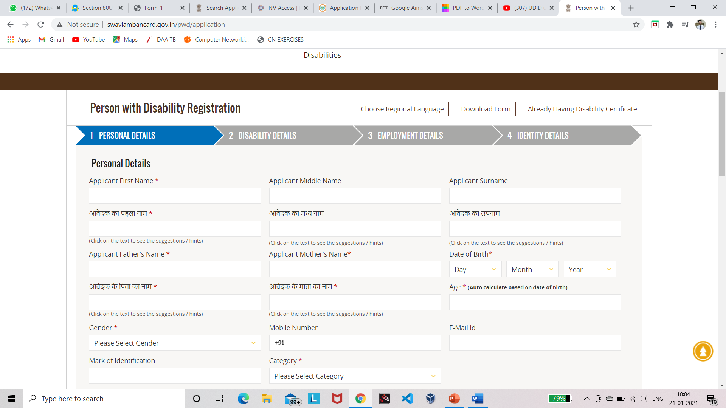
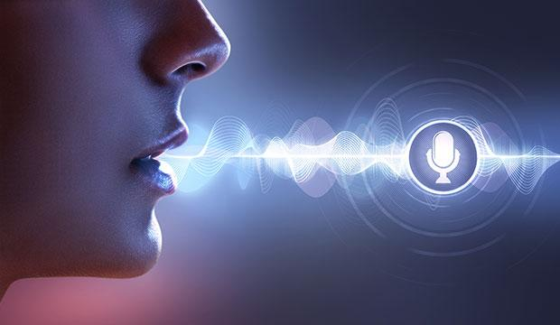
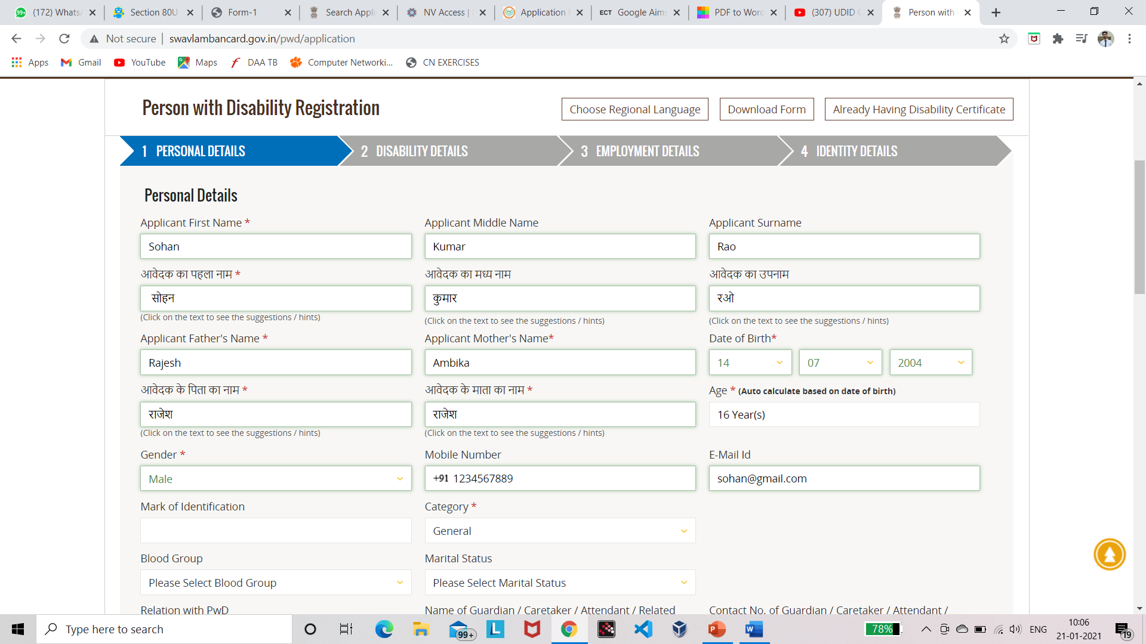


Unfilled UDID form User’s voice (English) Filled UDID form

Slide 5
Scope
1
Language of choice to fill the form restricted to English
2
Restricted to the UDID (Unique Disability ID) form
3
For file inputs, manual input by the user would be required

Slide 6
Problem Statement
PROBLEM STATEMENT
Current scenario
Non-viable for the differently abled, especially the visually impaired to access technology
Why is current scenario non-viable?
Accessing technology requires visual perception & prior knowledge of computer’s working
Problem we want to solve
Simplify the online UDID form filling process
Our goal
Give the differently abled a sense of independence

Slide 7
Literature Survey
Paper 1 : A framework to integrate speech-based interface for blind web users on the websites of public
interest
Year of publication : 2013
Authors: Prabhat Verma, Raghuraj Singh and Avinash Kumar Singh
Summary
Blind persons are unable to perform tasks using internet that are relatively easily done by persons without such disability.
While browsing for some news article, e-book or collecting information on some topics might be easily accomplished using screen readers, complex tasks such as filling forms might not be very feasible for the blind.
This paper mentions some of these issues and challenges and a framework to solve them. The framework comprises of a dedicated speech-based interface that can be provided on an existing website of public interest by its owner, to provide its important services to the blind users.

Slide 8
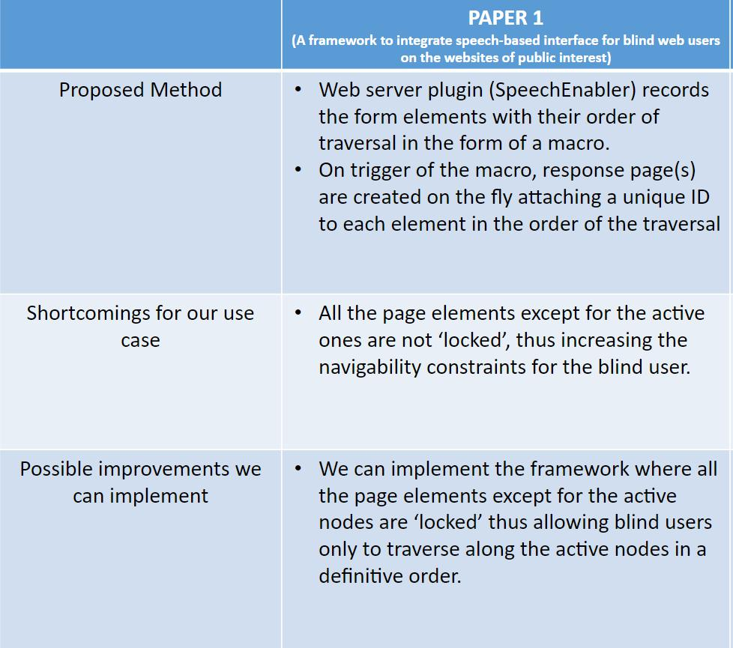

Slide 9
Paper 2: Noisy Speech Recognition using Wavelets and FCM
Year of publication: 2016 Authors: Vani H.Y, Anusuya M.A Summary
This paper is towards increasing the robustness of speech recognition in the noisy environment by using wavelet technique in the pre-emphasis phase.
Robustness of the system & Speech recognition rate declines in the presence of background noise and it varies for different types of noises.
This paper highlights the importance of applying wavelets and Fuzzy Clustering (soft clustering) technique in improving the performance of the speech recognition system.
To improve the speech recognition performance, wavelet analysis is applied with two approaches(discussed in methodology).

Slide 10
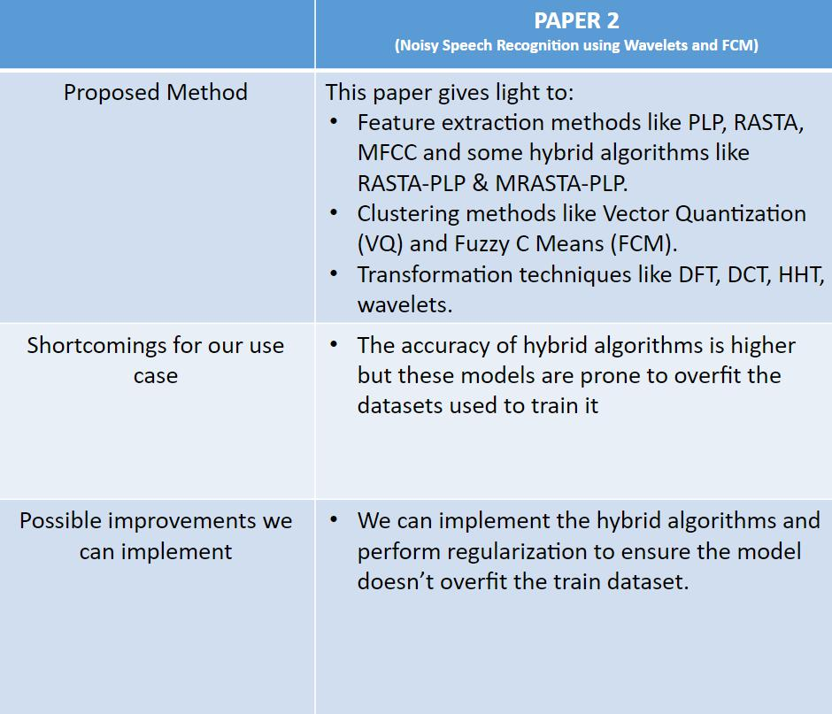

Slide 11
Paper 3: Implementation of Speech to Text Conversion
Year of publication : 2015
Authors: Prachi Khilari , Prof. Bhope V. P.
Summary:
This paper gives an overview of major technological perspective and appreciation of the fundamental progress of speech to text conversion and also gives complete set of speech to text conversion based on Raspberry-Pi.
A comparative study of different technique is done as per stages.
This paper concludes with the decision on future direction for developing technique in human computer interface system in different mother tongue and it also discusses the various techniques used in each step of a speech recognition process

Slide 12
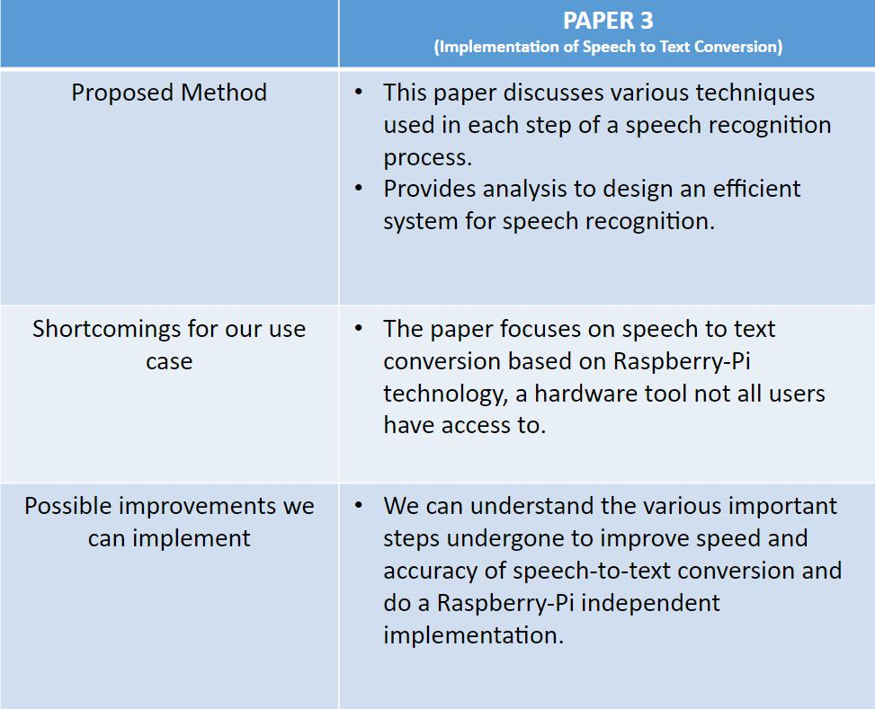

Slide 13
Paper 4: Query Understanding via Intent Description Generation
Year of publication: 2020
Authors: Ruqing Zhang, Jiafeng Guo, Yixing Fan, Yanyan Lan, and Xueqi Cheng
Summary:
In this paper, they propose a novel Query-to-Intent-Description (Q2ID) task for query understanding.
Q2ID is a reverse task which aims to generate a natural language intent description based on both relevant and irrelevant documents of a given query.
To address this new task, they propose a novel Contrastive Generation model, namely CtrsGen for short, to generate the intent description by contrasting the relevant documents with the irrelevant documents given a query.
They demonstrate the effectiveness of their model by comparing with several state-of-the-art generation models on the Q2ID task.

Slide 14
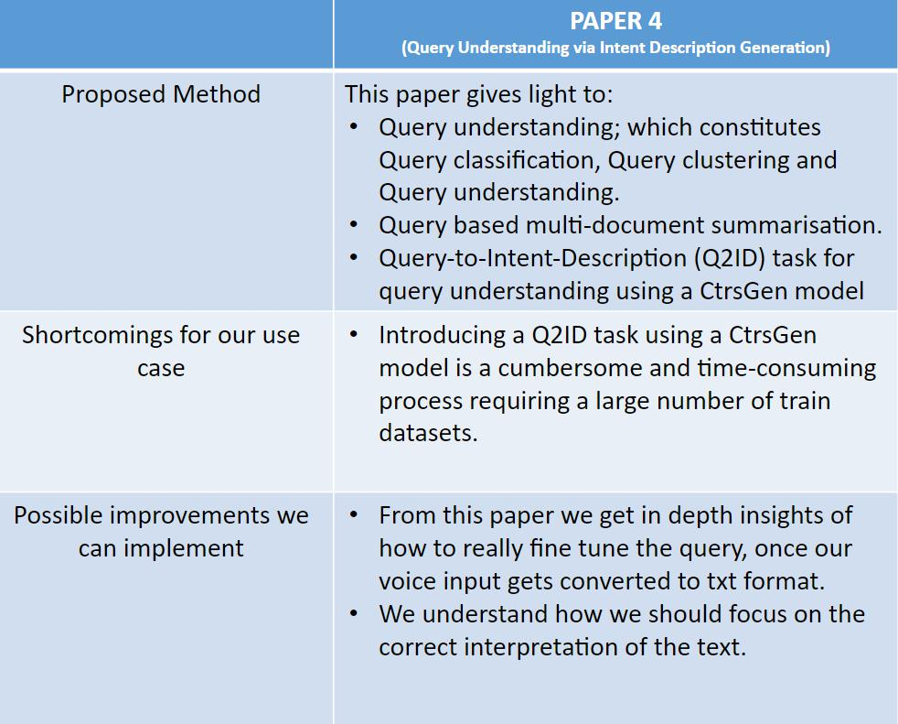

Slide 15
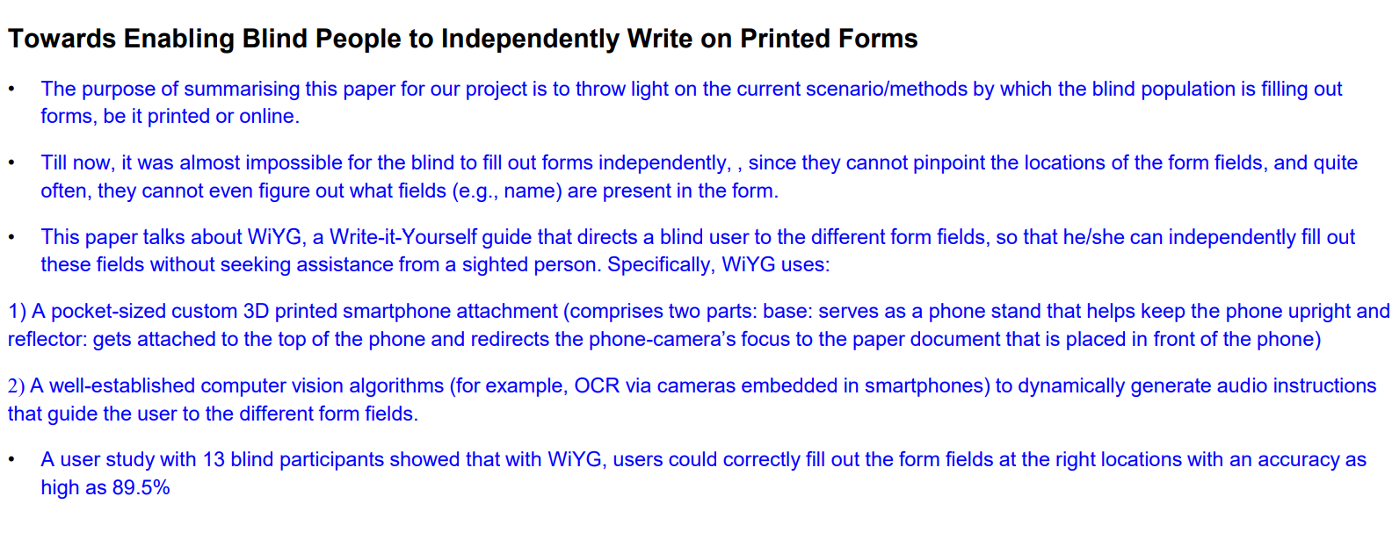
Paper 5

Slide 16
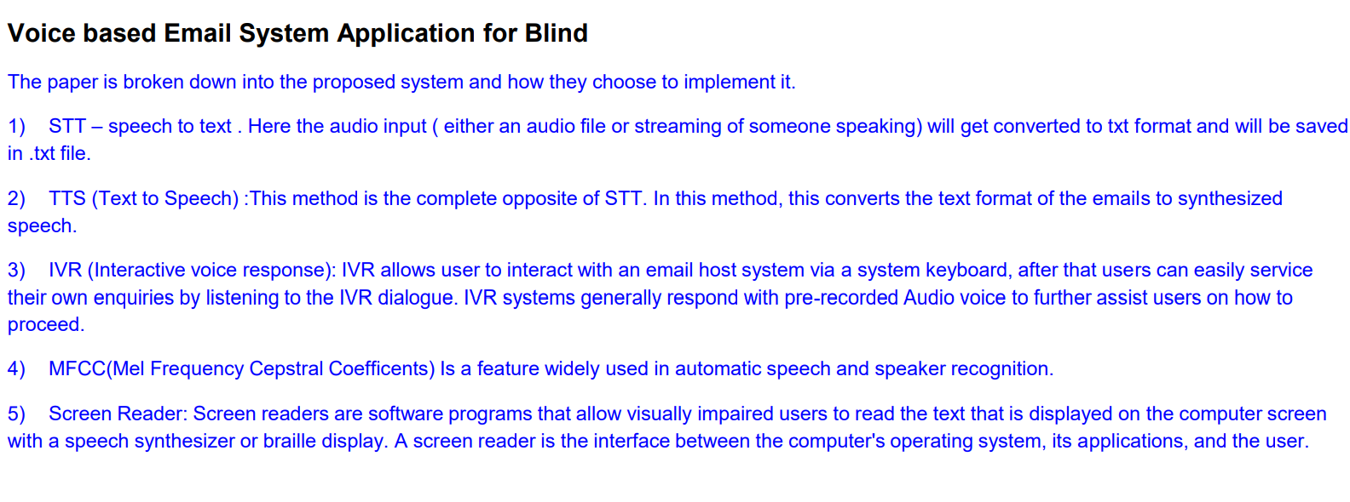
Paper 6

Slide 17
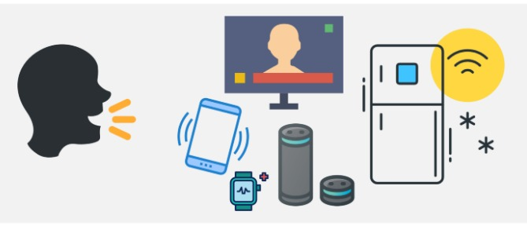
Suggestions from Review - 3
By the end of Phase-2, completely make the “system-user” interaction voice-based, emulating a chatbot like scenario to open and access the form

Slide 18
Design Constraints, Assumptions & Dependencies
CONSTRAINTS
Capturing voice input accurately
Identifying different dialects
Minimum intermediate & end-to-end delay in the whole process
Achieving real time analysis with >80% accuracy

Slide 19
ASSUMPTIONS
User grants permission to securely use their data
User has a system and stable internet
User’s system has:
a) Microphone
b) Braille keyboard (if visually impaired)
User provides relevant and appropriate answers to respective form questions

Slide 20
DEPENDENCIES
1
Clarity of the user’s microphone, ensuring clear voice inputs are recorded
2
System’s memory: A minimum of 2 Gb RAM
3
System’s Processor Power: Minimum requirement of an Intel i3 processor

Slide 21
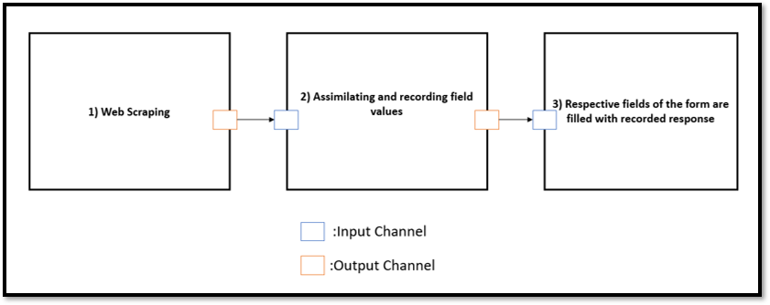
Proposed Methodology / Approach

Slide 22
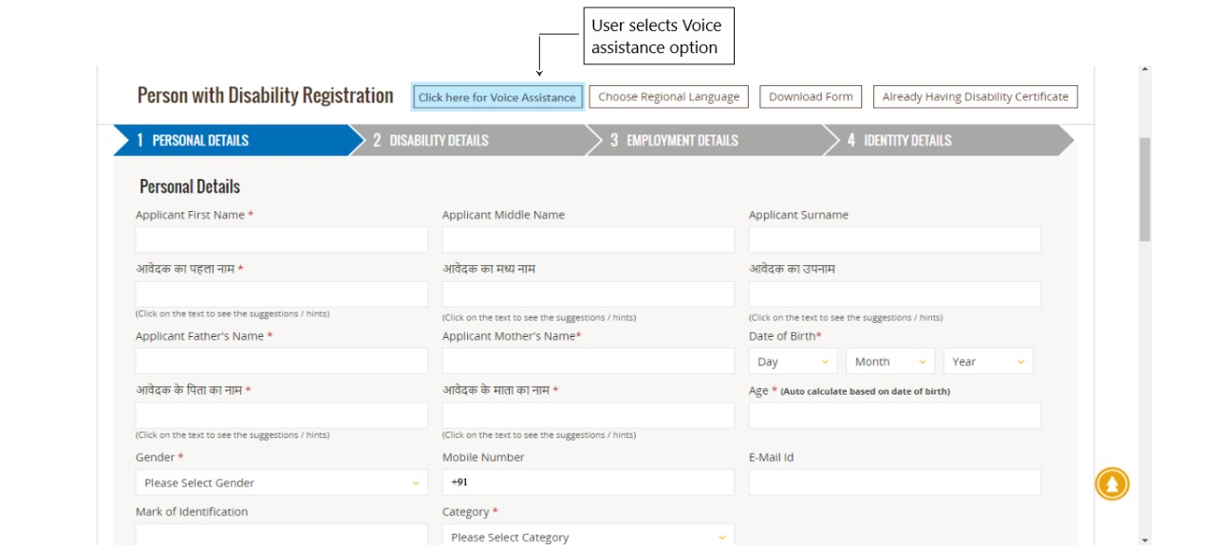
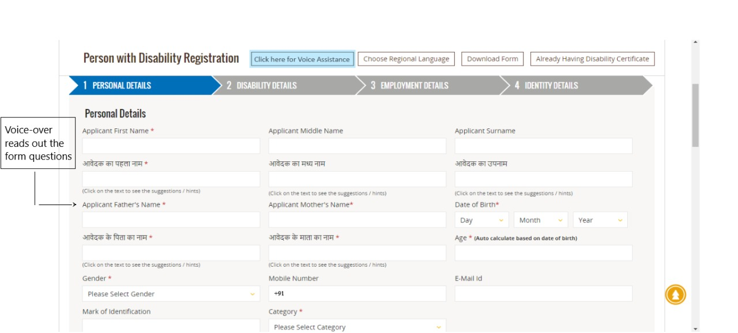
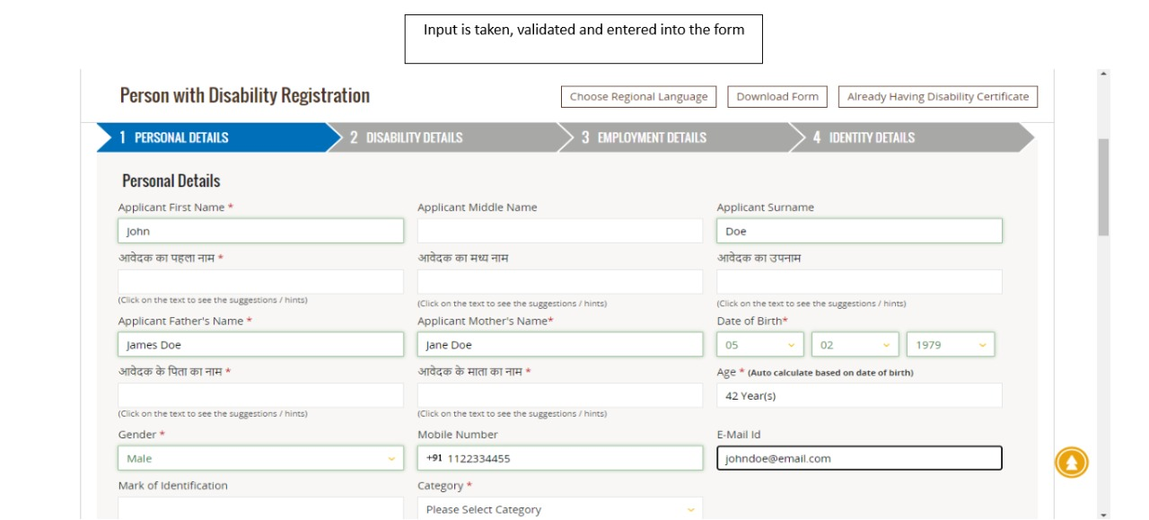

What is your name?
My name is John Doe
Is that spelt J O H N D O E?
Yes
Okay.
What is your father’s name?....

Slide 23
System asks user a question
UNCLEAR RESPONSE
Repeat
UNCLEAR RESPONSE
CLEAR RESPONSE
Confirmation
NO
Repeat / Spell it out
YES
Response recorded and next prompt presented to user
Same process is followed for forthcoming prompts
Form is filled using stored records

Slide 24


Several recursive processes asking user for:
a) Clearer response
b) Confirmation to responses
Takes more time
Repetitive
DRAWBACKS
User will spell out words not understood by the system
User irritation if there’s high frequency of such words

Slide 25
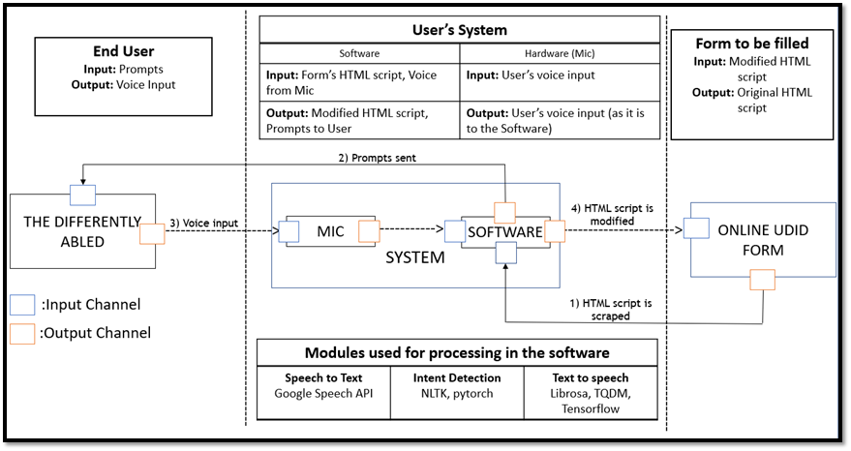
Architecture

Slide 26

Design Description
User Interface Diagrams

Slide 27


Slide 28
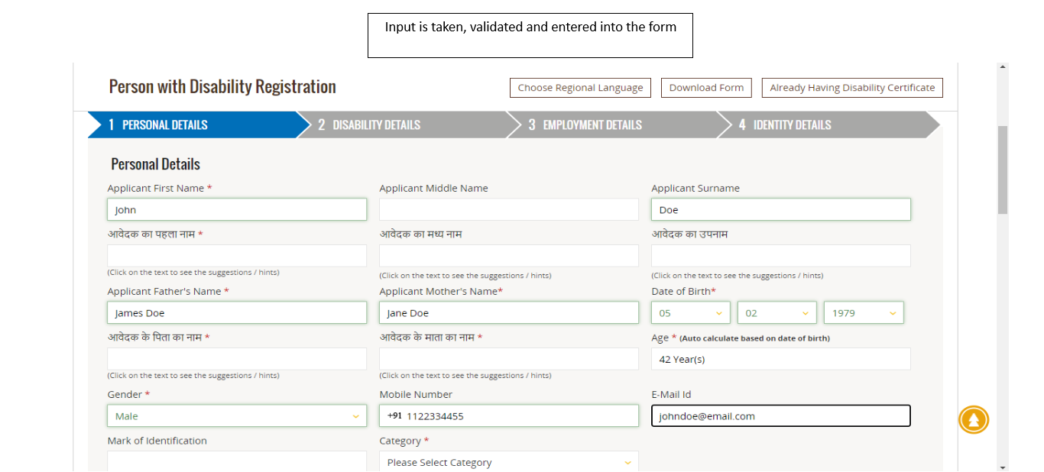

Slide 29
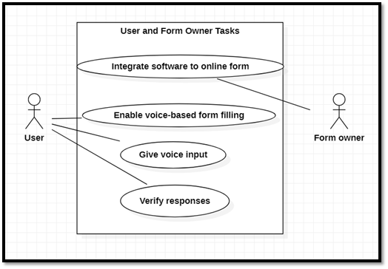
Use Case Diagram

Slide 30
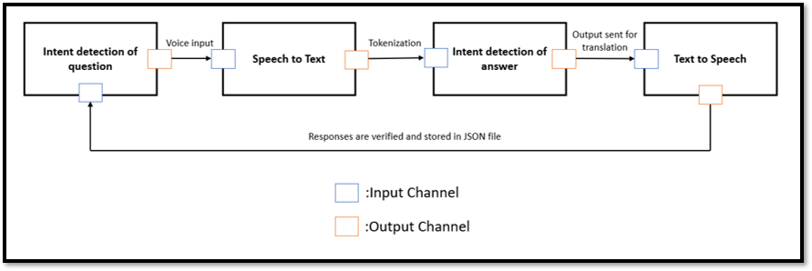
Processes and Data flow within the Software

Slide 31
Technologies Used
TECHNOLOGIES USED
Module 1: Speech To Text
Google Speech API
Module 2: Intent detection
NLTK, Pytorch
Module 3: Text to speech
Librosa, TQDM, Tensorflow
Code/implementation
Python 3

Slide 32
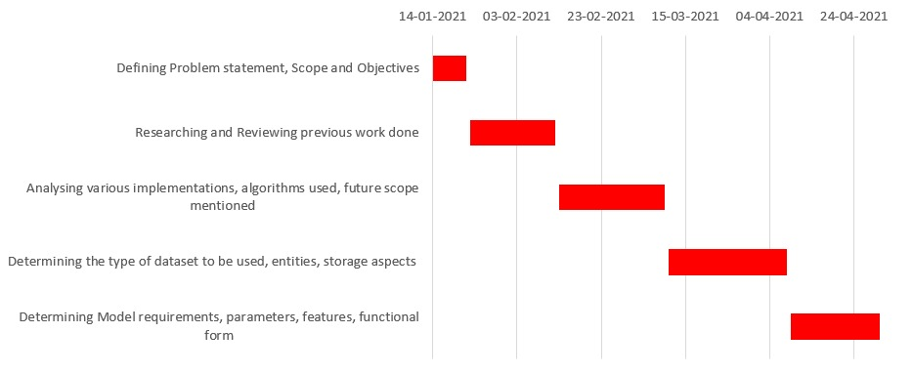
Project Progress
Project Completion: 25%

Slide 33
Walkthrough
We will be showing you a demo of our implementation progress

Slide 34
Summary of work done in Capstone Phase-1
Extensive research on existing papers related to how the visually impaired navigate through online forms; how they use the computer system in general; and what additional hardware and software components are required to make their navigational process easier.
In depth research of the functionalities needed to implement voice based form filling, such as, speech to text conversion, query intent detection
Decided on modules and resources for implementation:
Datasets: LJ Speech Dataset, ATIS
Modules: Google speech API, NLTK, Pytorch, Librosa, TQDM etc.

Slide 35
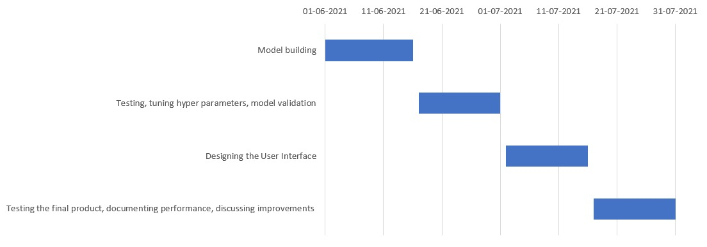
Project Plan for Capstone Phase-2

Slide 36
References
H. Y. Vani and M. A. Anusuya. 2016. Noisy Speech Recognition using Wavelets and FCM. In Proceedings of the 4th International Conference on Information and Network Security (ICINS '16). Association for Computing Machinery, New York, NY, USA, 83–88.
DOI:https://doi.org/10.1145/3026724.3026737
https://hcis-journal.springeropen.com/track/pdf/10.1186/2192-1962-3-21.pdf
Verma, Prabhat, Raghuraj Singh, and Avinash Kumar Singh. "A framework to integrate speech based interface for blind web users on the websites of public interest." Human-Centric Computing and Information Sciences 3.1 (2013): 1-18.
https://hcis-journal.springeropen.com/track/pdf/10.1186/2192-1962-3-21.pdf
Khilari, Prachi, and V. P. Bhope. "Implementation of speech to text conversion.“ International Journal of Innovative Research in Science, Engineering and Technology 4.7 (2015): 6441-6450.
https://www.ijirset.com/upload/2015/july/167_IMPLEMENTATION.pdf

Slide 37
Shirin Feiz, Syed Masum Billah, Vikas Ashok, Roy Shilkrot, and IV Ramakrishnan. 2019. Towards Enabling Blind People to Independently Write on Printed Forms. In <i>Proceedings of the 2019 CHI Conference on Human Factors in Computing Systems</i> (<i>CHI '19</i>). Association for Computing Machinery, New York, NY, USA, Paper 300, 1–12. DOI:https://doi.org/10.1145/3290605.3300530
https://dl.acm.org/doi/10.1145/3290605.3300530
Ingle, Pranjal, Harshada Kanade, and Arti Lanke. "Voice based e-mail System for Blinds." International Journal of
Research Studies in Computer Science and Engineering (IJRSCSE) 3.1 (2016): 25-30.
https://www.arcjournals.org/pdfs/ijrscse/v3-i1/5.pdf

Slide 38
Thank You

